Slide 1
Abstraction: https://helpmecoder.com/2019/03/26/angular-tutorial-introduction-to-angular/ https://v2.angular.io/docs/ts/latest/guide/lifecycle-hooks.html
Spring Boot Data JPA with Angular crud operations with proper exception handling and validations

Slide 2
What is Spring Boot ?
Spring Boot is the combination of Spring Framework and Embedded Servers.
In Spring Boot, there is no requirement for XML configuration (deployment descriptor). It uses convention over configuration software design paradigm that means it decreases the effort of the developer.

Slide 3
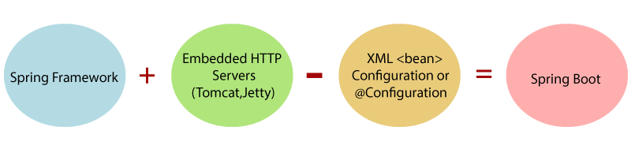
What is Spring Boot ?

Slide 4
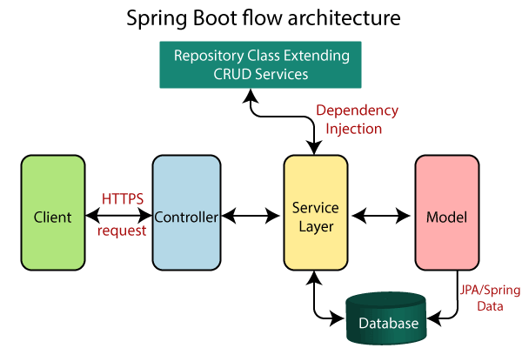
Architecture

Slide 5
Spring Boot uses all the modules of Spring-like Spring MVC, Spring Data, etc.
The architecture of Spring Boot is the same as the architecture of Spring MVC, except one thing: there is no need for DAO and DAOImpl classes in Spring boot.
Creates a data access layer and performs CRUD operation.
The client makes the HTTP requests (PUT or GET).
The request goes to the controller, and the controller maps that request and handles it. After that, it calls the service logic if required.
In the service layer, all the business logic performs. It performs the logic on the data that is mapped to JPA with model classes.
A JSP page is returned to the user if no error occurred.

Slide 6
Angular
Angular 7 is a JavaScript (actually a TypeScript based open-source full-stack web application) framework which makes you able to create reactive Single Page Applications (SPAs).
Angular 7 is completely based on components.
It consists of several components which forms a tree structure with parent and child components.
Angular's versions beyond 2+ are generally known as Angular only.

Slide 7
What is Single Page Application (SPA)
A single page application is a web application or a website which provides users a very fluid, reactive and fast.
A single-page application is an app that doesn’t need to reload the page during its use and works within a browser.
Think of the apps you use daily: Facebook, Google Maps, Gmail, Twitter, Google Drive, or even GitHub. All these are examples of a SPA.

Slide 8
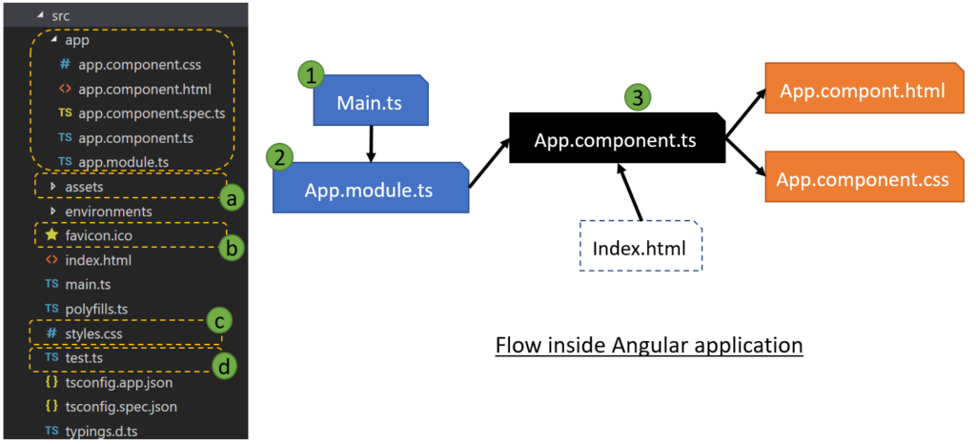
Angular application Flow

Slide 9
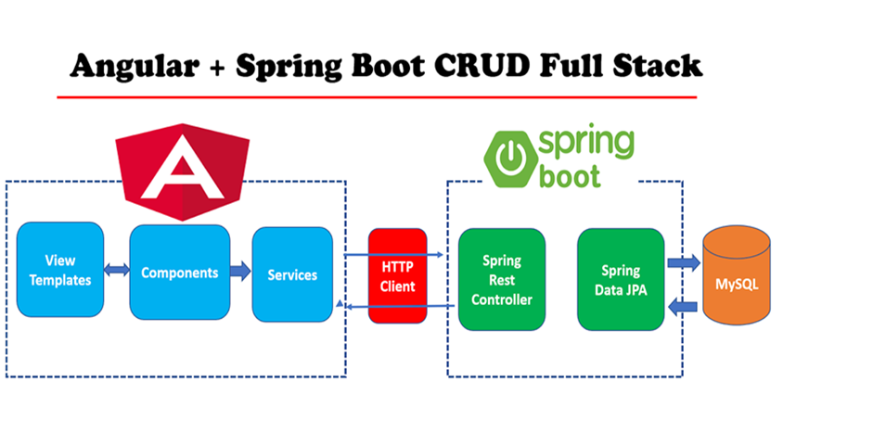
Employee Management System

Slide 10
What we will build?
Back-end :
springboot-jpa-crud: This project is used to develop CRUD RESTFul APIs using Spring Boot, JPA and MySQL/H2 as a database.
Front-end :
angular-springboot-client: This project is used to develop single page application using Angular as front-end technology. This Angular application consumes CRUD Restful APIs developed and exposed by a springboot-jpa-crud.

Slide 11
Tools and technologies used
Back end technologies
JDK - 1.8 or later
Spring Boot - 2.0.5.RELEASE
Spring Framework - 5.0.8 RELEASE
Hibernate - 5.2.17.Final
Spring Data JPA - 2+
Front end technologies
Angular 8.0.0
Bootstrap 4
npm- 6.9.0
JQuery
Tools
Maven - 3.2+
IDE - Eclipse or Spring Tool Suite (STS)
Visual Studio Code Editor
Angular CLI

Slide 12
Spring Boot + Angular 8 CRUD
Part 1 - Develop Spring Boot CRUD Rest APIs
Part 2 - Create Angular 8 App
Part 3 - Develop Angular 8 CRUD Operations
Part 4 - Angular 8 CRUD App Configuration
Part 5 - Running Angular 8 CRUD App

Slide 13
Look at the above diagram, we have specified the following details:
Generate: Maven Project
Java Version: 1.8 (Default)
Spring Boot:2.0.4
Group: com.springboot.jpa
Artifact: springbootbackend
Name: springbootbackend
Description: Rest API for a Simple Employee Management Application
Package Name : com.springboot.jpa .springbootbackend
Packaging: jar (This is the default value)
Dependencies: Web, JPA, MySQL, DevTools
Once, all the details are entered, click on Generate Project button will generate a spring boot project and downloads it.
Next, Unzip the downloaded zip file and import it into your favorite IDE.

Slide 14
Part 1 - Develop Spring Boot CRUD Rest APIs
create employee
list employee
delete employee
update employee
get employee by id

Slide 15
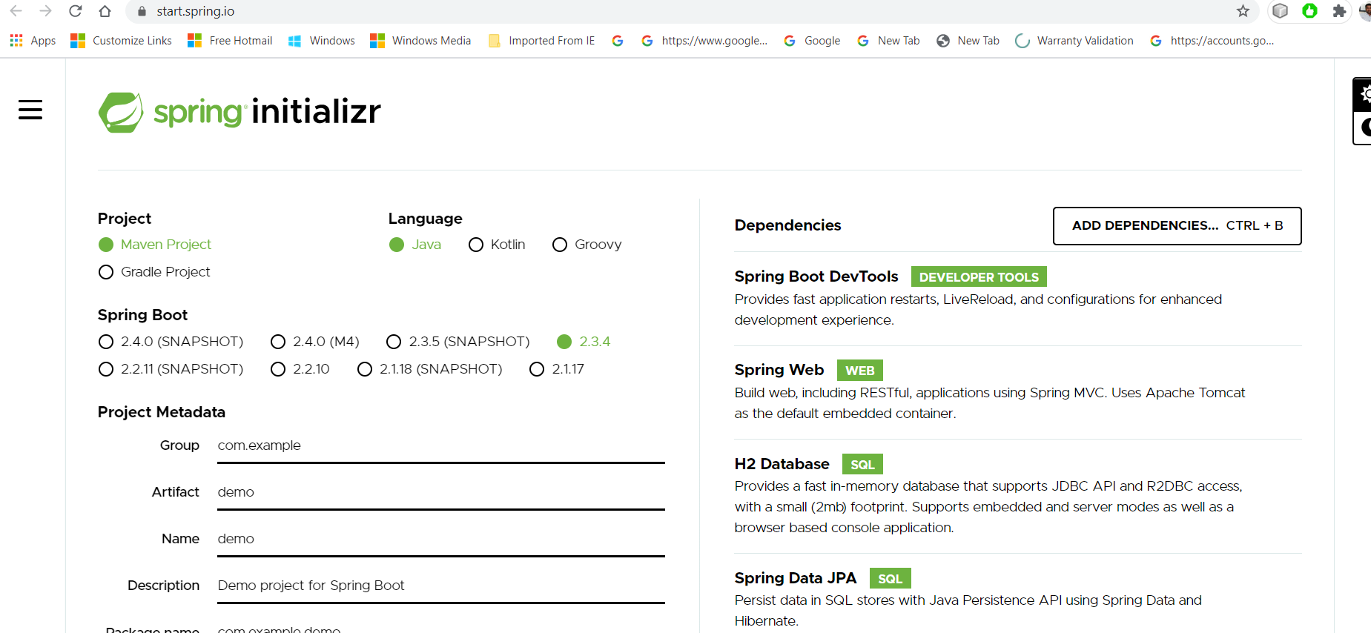
1. Creating and Importing a Project
There are many ways to create a Spring Boot application.
The simplest way is to use Spring Initialization http://start.spring.io/, which is an online Spring Boot application generator.

Slide 16
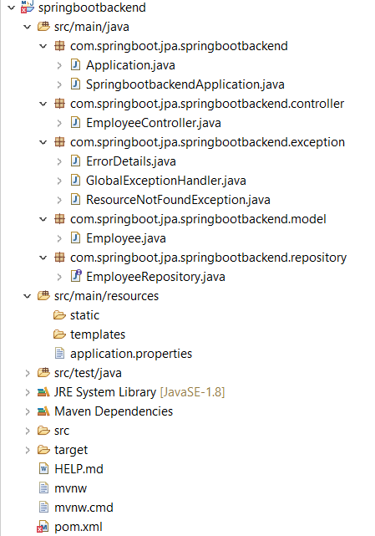
Packaging Structure

Slide 17
Part 2 - Create Angular 8 App
Install the latest version of Angular CLI
Create Angular 8 client application using Angular CLI
Identify Components, Services, and Modules
Create Service & Components using Angular CLI
Integrate JQuery and Bootstrap with Angular

Slide 19
To install Angular, we require the following −
Nodejs
install site :https://nodejs.org/en/
Npm :
Angular CLI
IDE for writing your code :You can download VS Code from here: https://code.visualstudio.com

Slide 20
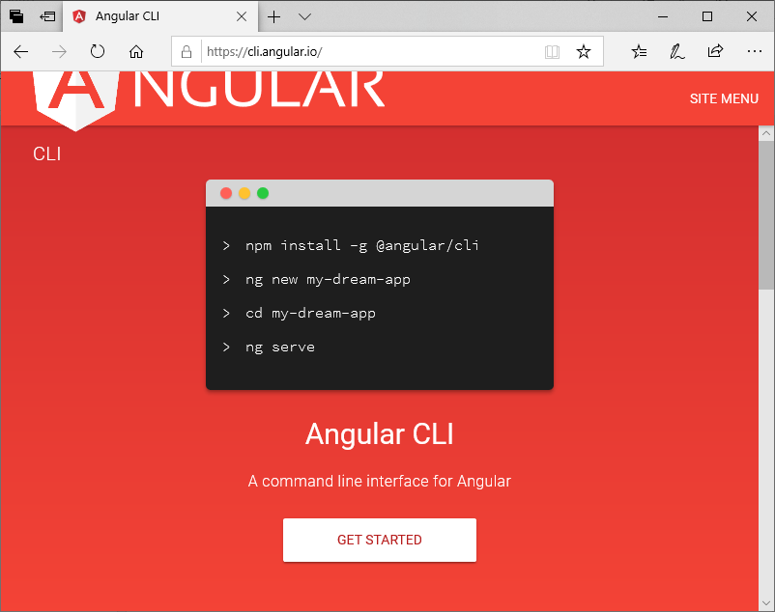

Slide 21
Identify Components, Services, and Modules
Components
create-employee
employee-list
employee-details
Services
employee.service.ts - Service for Http Client methods
Modules
FormsModule
HttpClientModule
AppRoutingModule
Employee Class (Typescript class)
employee.ts: class Employee (id, firstName, lastName, emailId)

Slide 22
Create Service & Components using Angular CLI
ng g s employee
– ng g c create-employee
– ng g c employee-details
– ng g c employee-list

Slide 23
Integrate JQuery and Bootstrap with Angular
Use NPM to download Bootstrap & JQuery. Bootstrap and jQuery will be installed into the node_modules folder.
npm install bootstrap jquery --save

Slide 24
Part 3 - Develop Angular 8 CRUD Operations
Create an Employee class
Employee Service
Creating Employee List Template and Component
Create Add Employee Template and Component
Update Employee Template and Component
Create View Employee Details Template and Component

Slide 25
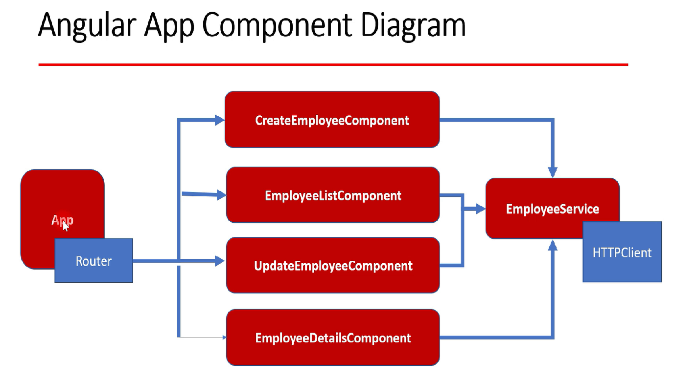

Slide 26
Part 4 - Angular 8 CRUD App Configuration
npm package.json - Configure Dependencies
App Routing Module
App Component
App Component Template
App Module
Main Index Html File
Main (Bootstrap) File
Polyfills
TypeScript tsconfig.json

Slide 27
Part 5 - Running Angular 8 CRUD App
Running Angular 8 Client Application
ng serve
Demo
Hit http://localhost:4200 link in a browser will host this Angular 8 CRUD app.

Slide 28
Features Implementation
Create an Employee
Update an Employee
List of Employees
Delete Employee
View Employee
You will developed your FULL STACK Application with Angular and Spring Boot.

Slide 29
Below are the screenshots shows UI of our Employee Management System

Slide 30
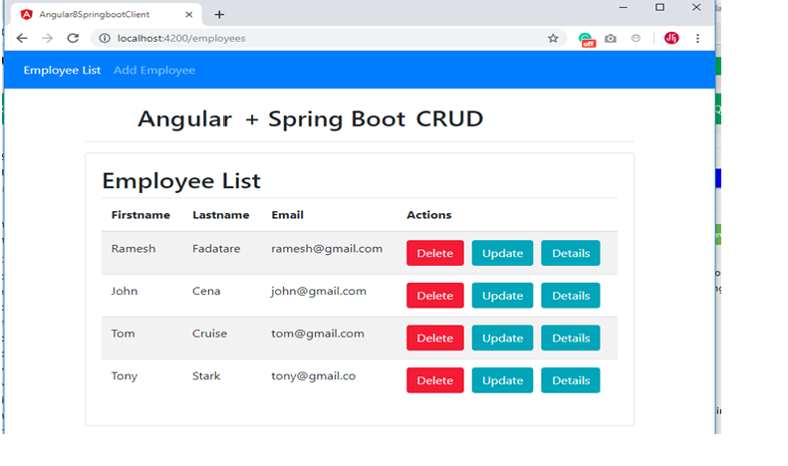
Employee List Page

Slide 31
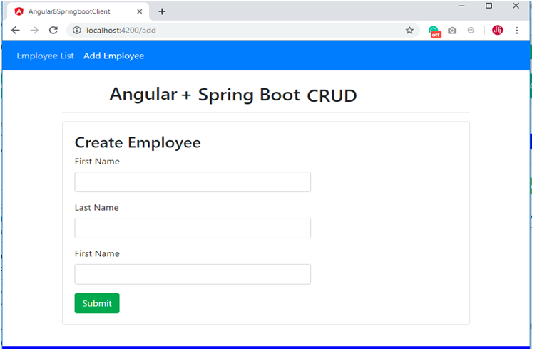
Add Employee Page

Slide 32
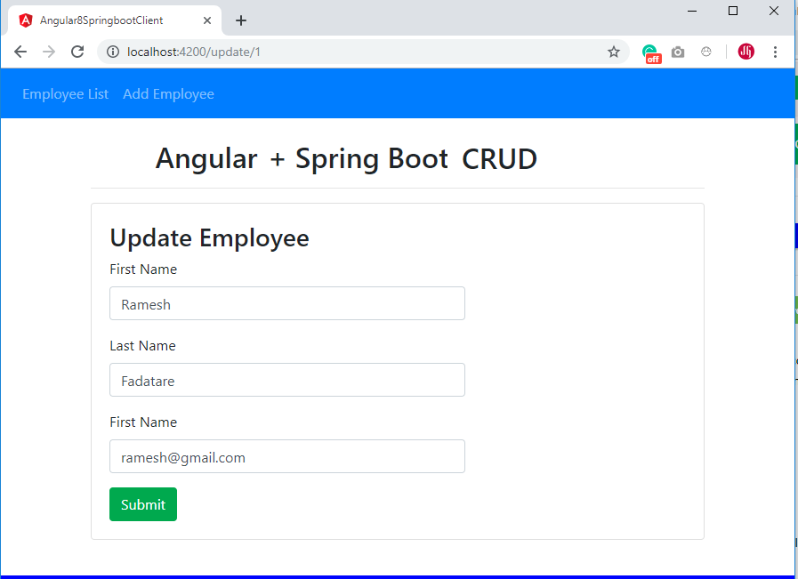
Update Employee Page

Slide 33
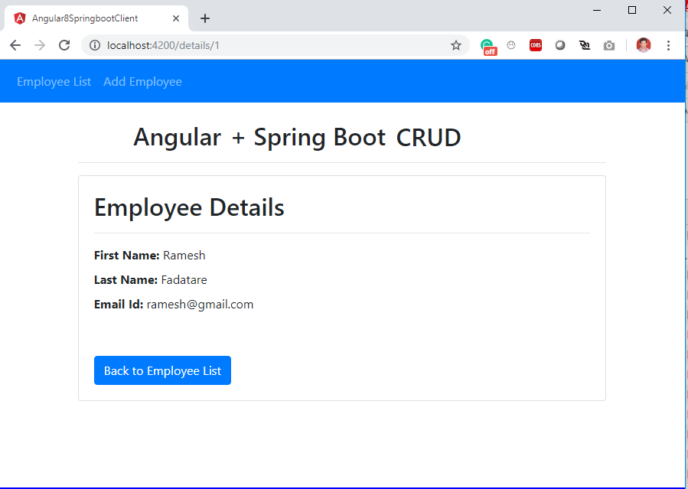
View Employee Details Page

Slide 34
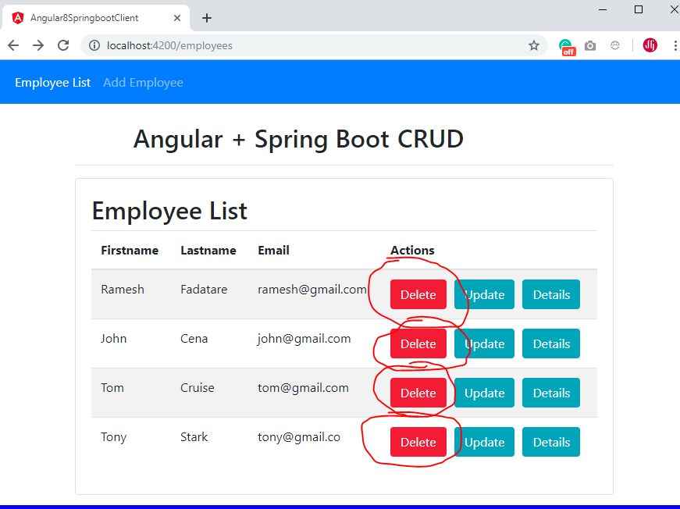
Delete Employee

Slide 35
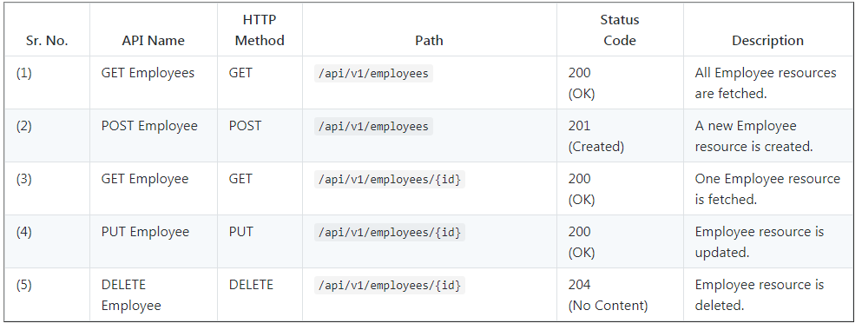
Spring Boot CRUD Rest APIs Development

Slide 36
Thank you

